Slide 1
Lecture # 9
Counting Sort

Slide 2
Theorem 8.1
Any comparison-based sorting algorithm has worst-case running time Ω(n log n)
    Proof: (Book Page No 167, 2nd Edition)

Slide 3
The lower bound implies that if we hope to sort numbers faster than O(n log n), we cannot do it by making comparisons alone.
Is it possible to sort without making comparisons?
The answer is yes, but only under very restrictive circumstances.

Slide 4
Counting Sort
We will consider Counting Sort algorithm that is faster and work by not making comparisons.
Counting sort assumes that the numbers to be sorted are in the range 1 to k where k is small. The basic idea is to determine the rank of each number in final sorted array.
The rank of an item is the number of elements that are less than or equal to it.
Once we know the ranks, we simply copy numbers to their final position in an output array.

Slide 5
Counting Sort
The algorithm uses three arrays. As usual,
A[1..n] holds the initial input,
B[1..n] holds the sorted output and
C[1..k] is an array of integers. C[x] is the rank of x in A, where x Є [1..k].

Slide 6
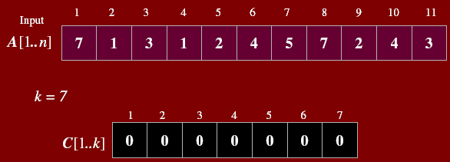
Example

Slide 7
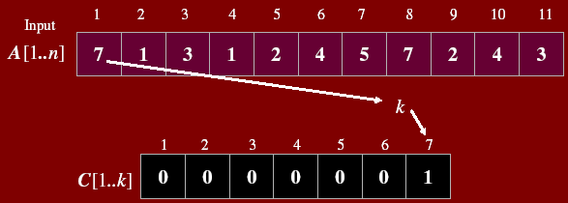
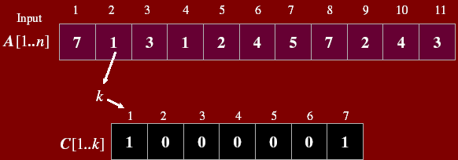

Slide 8
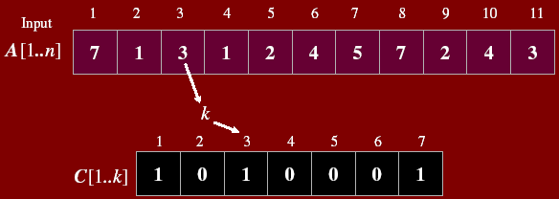
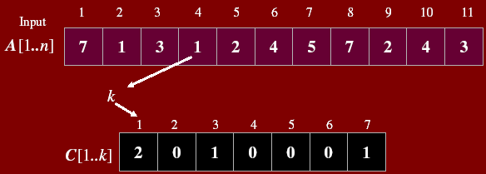

Slide 9
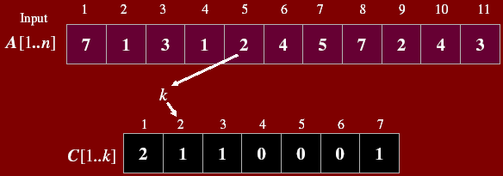
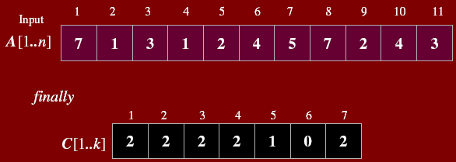

Slide 10
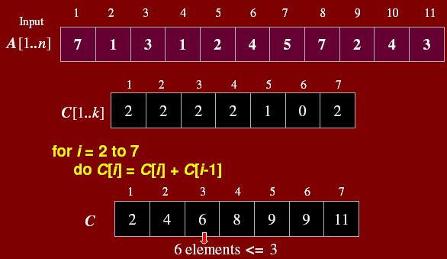

Slide 11
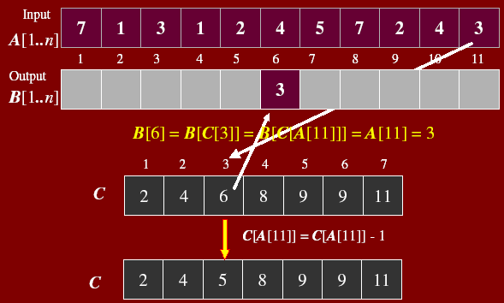

Slide 12
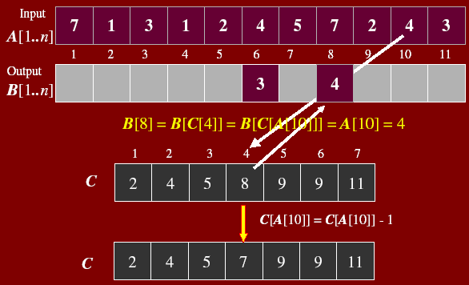

Slide 13
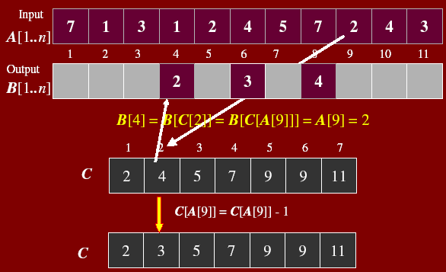

Slide 14
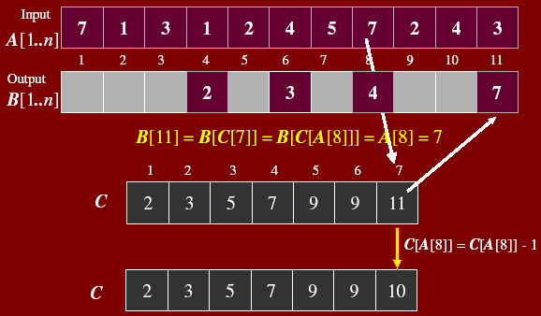

Slide 15
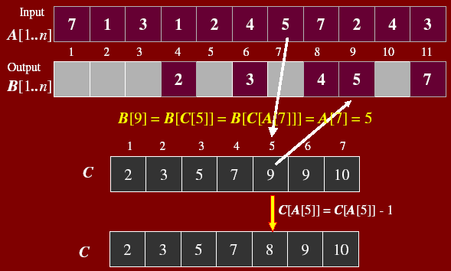

Slide 16
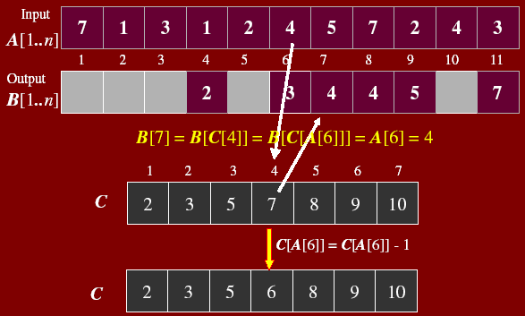

Slide 17
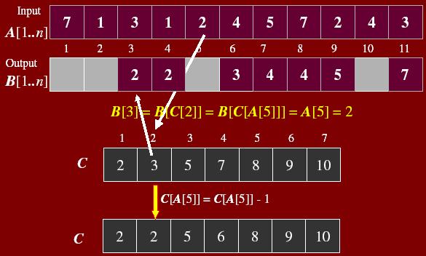

Slide 18
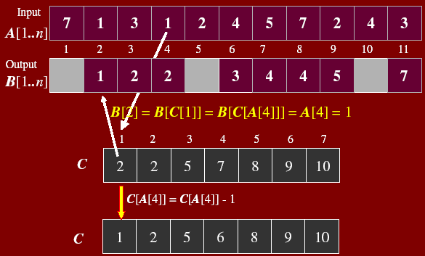

Slide 19
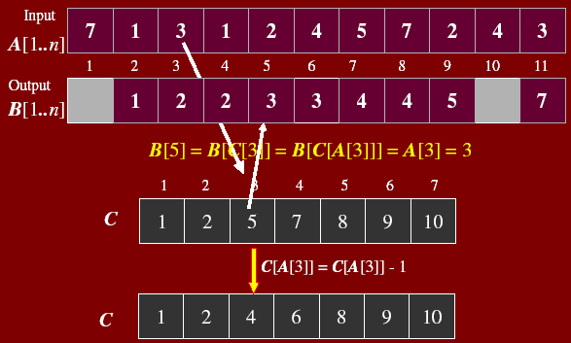

Slide 20
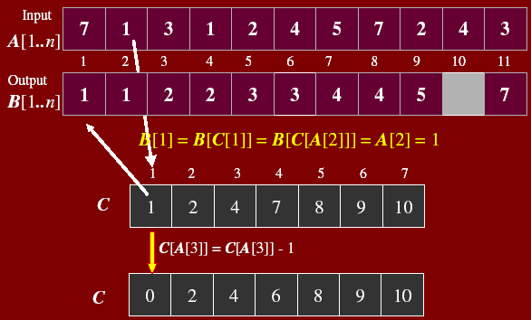

Slide 21
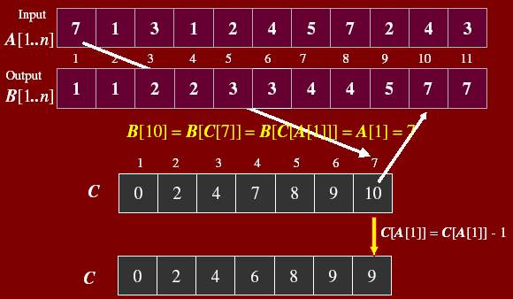

Slide 22
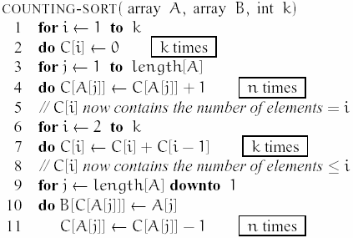
Counting Sort Algorithm

Slide 23
There are four (unnested) loops, executed k times, n times, k - 1 times, and n times, respectively,
so the total running time is Θ(n + k) time.
If k = Θ(n), then the total running time is Θ(n).

